Slide 1






Creator
Link
Mythic Giants

Slide 2


Introduction
CreatorLink -
A revolutionary social outreach platform
Streamlined Collaboration
Data-Driven Matchmaking
Pricing Suggestions
Smart Campaign Analytics
Audience Authenticity Check

Slide 3



Problem Statement
Being an influencer is a popular career option among the youth today. It is a diverse field with various niches for creative individuals. It also provides a unique opportunity for advertising products and businesses through targeted ads. As such, there is a necessity for a platform that connects creators to prospective advertising clients.

Slide 4


Solution
CreatorLink is a unique social platform that connects content creators with potential advertisers, streamlining the process of forming effective partnerships. The platform categorizes influencers based on audience size, content niche, platform presence, engagement metrics, and more, allowing advertisers to discover the most suitable creators for their campaigns. Advertisers can filter and select creators based on data-driven insights such as audience engagement, content relevance, reach, and campaign goals. This enables advertisers to create more personalized and effective advertising campaigns that resonate with their target audience.
Additionally, CreatorLink provides valuable analytics and performance metrics to both creators and advertisers, allowing them to track the success of their campaigns and make data-driven decisions for future collaborations. This results in more impactful campaigns, higher engagement, and better ROI for both advertisers and creators.

Slide 5



Use Cases
Considering a creator whose primary theme is tech news and reviews, they would be most suitable for tech companies looking to advertise new products/services.
Other examples could be a cosmetic company advertising a new line of products through a social media influencer, or a new up-and-coming restaurant being showcased by a food blogger.
With our platform, companies can select their partners based on their specific needs such as size, demographic, reach, and other parameters, which are evaluated through extensive data analysis and performance metrics, helping them target their campaigns effectively to promising clients.
This benefits both parties by allowing advertising to be more cost-efficient for the advertiser, financially supporting the creator, and providing them with an uplift in exposure.

Slide 6

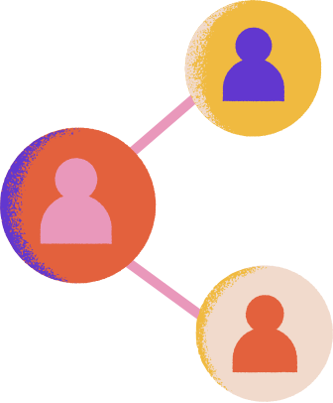












Roadmap
Creator Market Fit
Audience Alignment
Post Sponsorship Analytics
Companies define their marketing needs and present their goals.
After getting the demographic information from the creator,
audience is better matched with sponsorships
After having done the sponsor deal, the companies get feedback on their ad-read based on many metrics.
01
03
05
Sign-up
Creator API
Sponsorship Negotiation
02
Creators provide access to their analytics dashboard since the YouTube public API is limited in the information that it provides
04
06
In this initial phase, both Creators and Companies create an account on Creator link
Creators interact with the companies through our platform.

Slide 7
AI-Driven Features Enhancing CreatorLink
Dynamic Pricing Models-
Suggest implementing dynamic pricing through AI for sponsorships based on creator popularity, audience engagement, seasonal demand, and market trends. This ensures fair pricing for all parties involved.
Campaign Optimization Suggestions-
Provide recommendations for optimizing active campaigns. This can be achieved by adjusting posting times, and content format, or by developing new targeting strategies to enhance engagement and results.
Content Performance Insights
Our platform offers analytics that extend beyond basic metrics and provide insights into the best-performing content for specific demographics. This helps creators refine their content strategy and gives advertisers a clearer picture of what to expect.

Slide 8

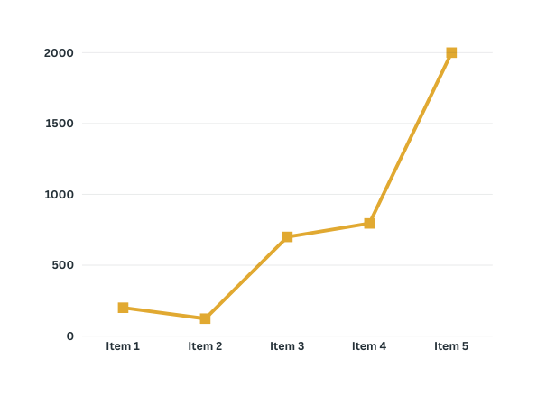
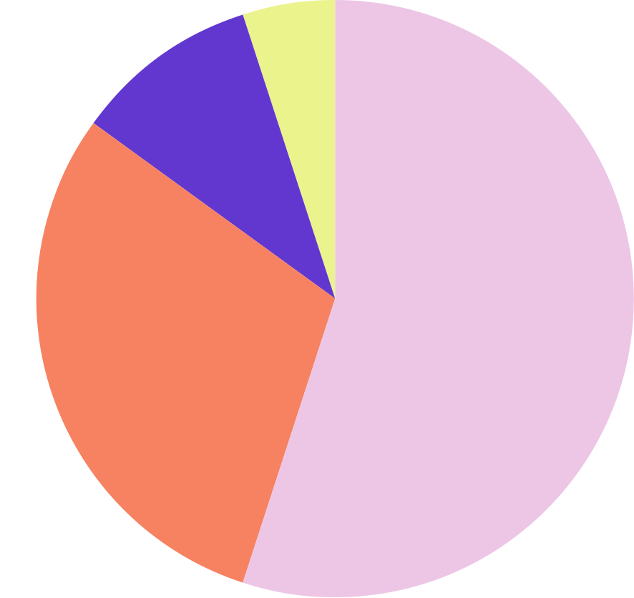
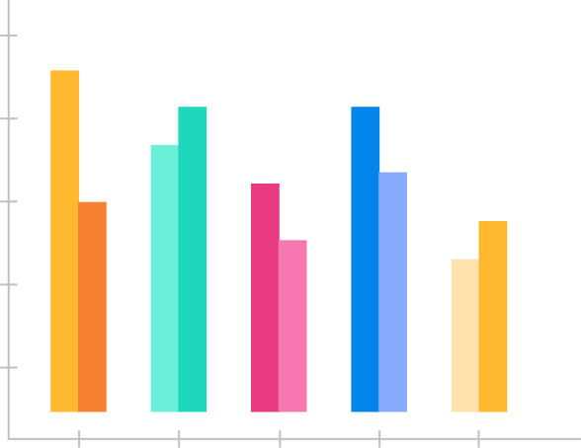

Analysis
Provides detailed analysis of the creators and advertisers with data-driven insights and valuable analytics.
Views, Likes and Comments
Subscriber Engagement
Reach

Slide 9


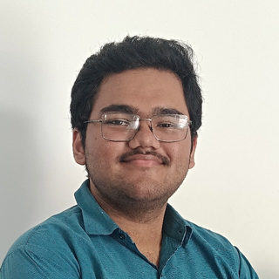

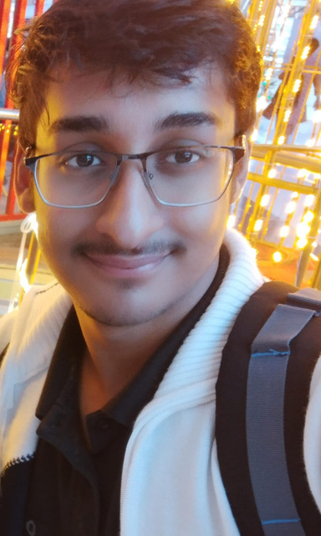
Our Team
Somesh
Nirvaan
Team leader
Shaurya
Soham

Slide 10


Thank You

